Slide 1
The spiritual exercises
Source of Ignatian Spirituality
and
Powerful Tool for Growth in Holiness

Slide 2
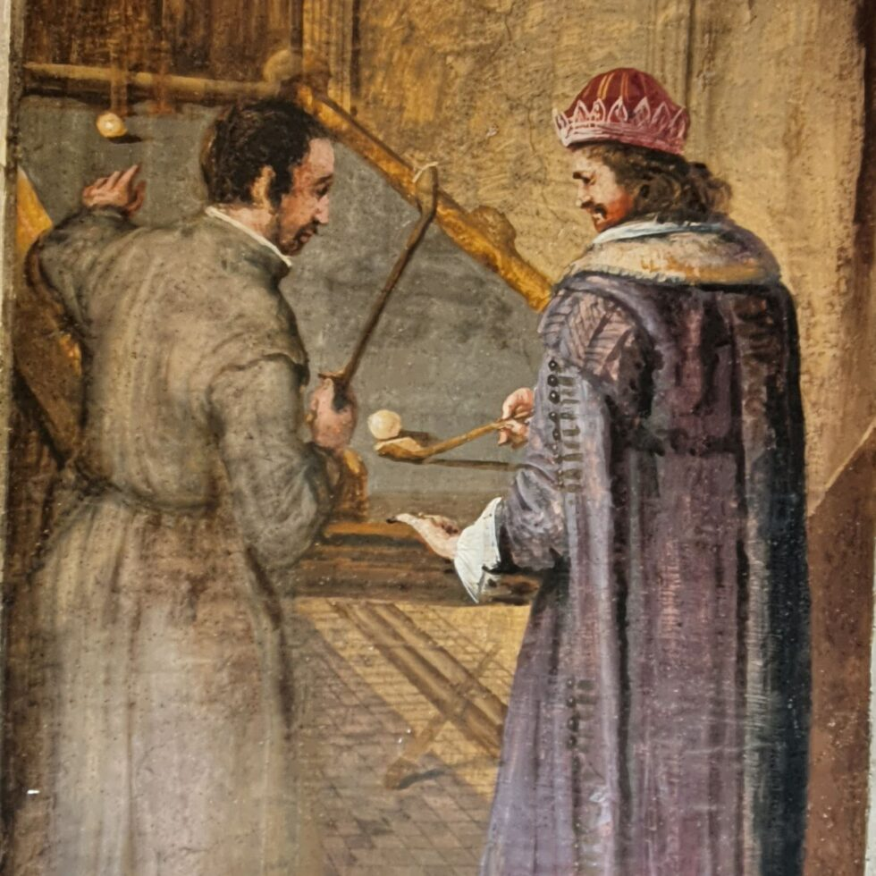

Slide 3
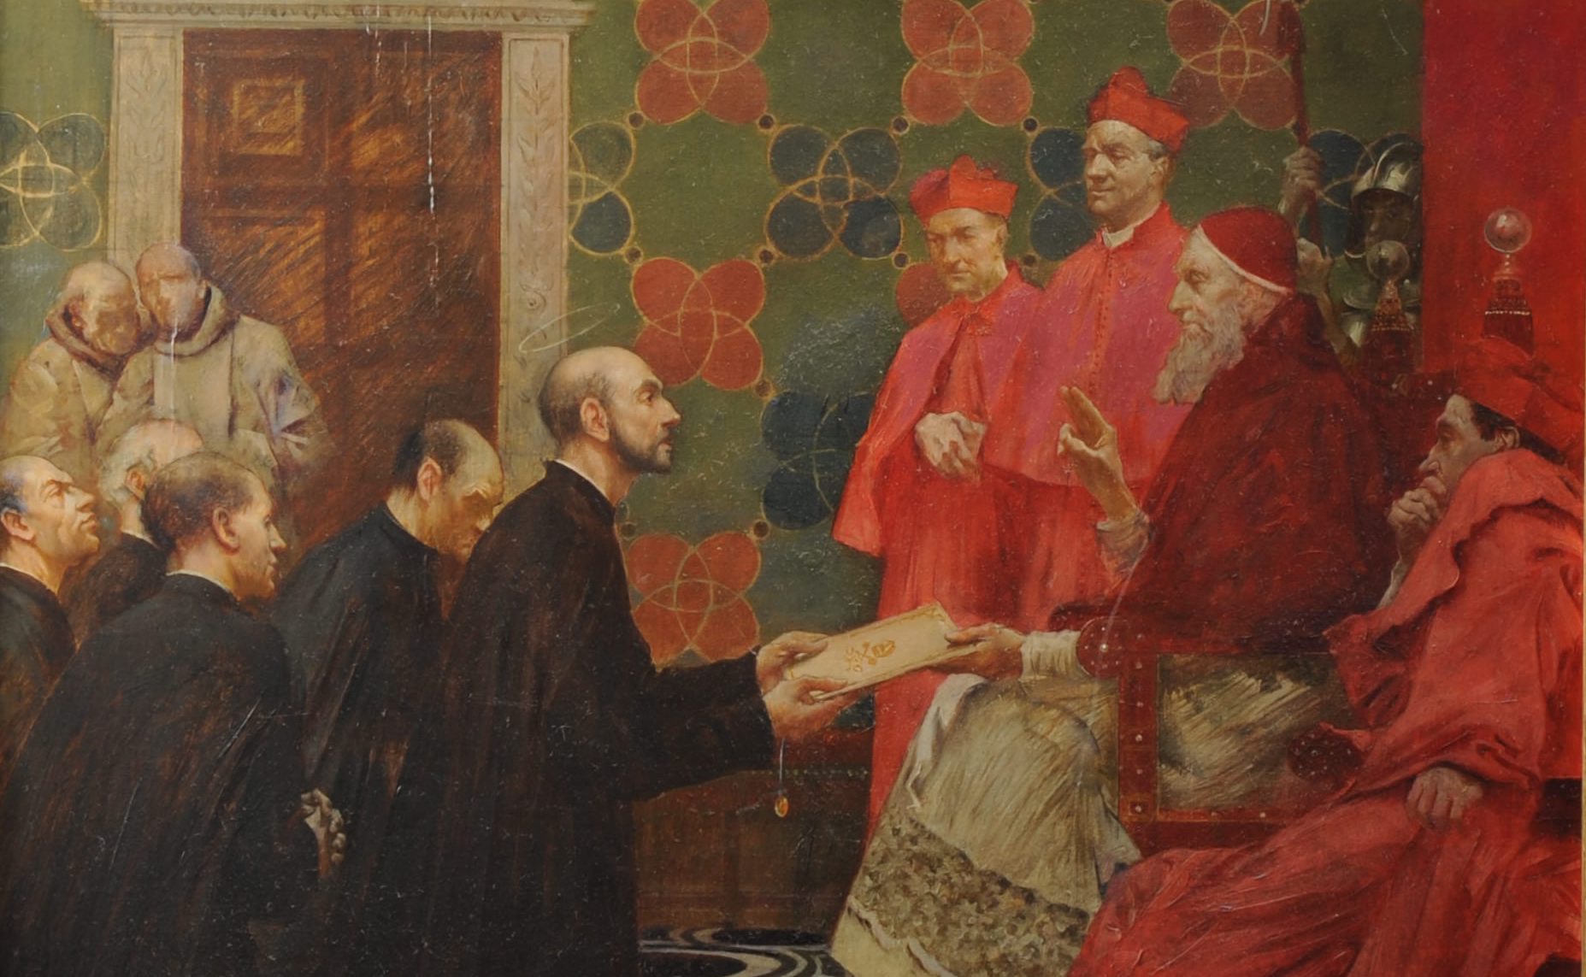
Spiritual Exercises Beginning and Approval
St. Ignatius’ spiritual experience in the cave at Manresa gave rise to the Spiritual Exercises.
He used the retreat to convert sinners and form saints.
Finally in 1548 the Spiritual Exercises were officially approved by Pope Paul III.

Slide 5
Structure of the Spiritual Exercises
Week 1: Consideration of sin in order to purify the soul
Week 3: The Passion and Death of Christ
Week 2: The life of Christ until Palm Sunday
Week 4: The Resurrection and Ascension of Jesus

Slide 6
Why the spiritual exercises are so effective

Slide 7
2 General Areas in which the Spiritual Exercises help the human person find God:
Natural
Parts of our normal human life that need to be directed to God and guided in order not to be obstacles
Supernatural
Elements of our life of faith that are strategically used to help us better find God

Slide 8
Human Elements in the Spiritual Exercises

Slide 9
Human Elements in the Spiritual Exercises
Silence
Quieting all noises and distractions that can keep us from hearing God

Slide 10
Human Elements in the Spiritual Exercises
Silence
Quieting all noises and distractions that can keep us from hearing God
Intense Activity
Not reduced to passivity, but rather a lively use of our interior powers

Slide 11
Human Elements in the Spiritual Exercises
Silence
Quieting all noises and distractions that can keep us from hearing God
Intense Activity
Not reduced to passivity, but rather a lively use of our interior powers
All Powers
Use and focusing of all the interior, human capacities, aiming them at the goal of prayer

Slide 12
Human Elements in the Spiritual Exercises
Silence
Quieting all noises and distractions that can keep us from hearing God
Intense Activity
Not reduced to passivity, but rather a lively use of our interior powers
All Powers
Use and focusing of all the interior, human capacities, aiming them at the goal of prayer
Self-Reflection
Constant practice of being aware of and examining one’s interior

Slide 13
Human Elements in the Spiritual Exercises
Silence
Quieting all noises and distractions that can keep us from hearing God
Intense Activity
Not reduced to passivity, but rather a lively use of our interior powers
All Powers
Use and focusing of all the interior, human capacities, aiming them at the goal of prayer
Self-Reflection
Constant practice of being aware of and examining one’s interior
Practical Tips
Many practical tips aimed at helping to draw more profit from prayer

Slide 14
Supernatural Elements in the Spiritual Exercises

Slide 15
Supernatural Elements in the Spiritual Exercises
Prayer
It is a school of prayer, giving so much time and so many ways to pray

Slide 16
Supernatural Elements in the Spiritual Exercises
Prayer
It is a school of prayer, giving so much time and so many ways to pray
God Guides
The soul is prepared to be guided primarily by God alone

Slide 17
Supernatural Elements in the Spiritual Exercises
Prayer
It is a school of prayer, giving so much time and so many ways to pray
God Guides
The soul is prepared to be guided primarily by God alone
Christ-Centered
Focused on coming to know and imitate a Person, Jesus Christ

Slide 18
Supernatural Elements in the Spiritual Exercises
Prayer
It is a school of prayer, giving so much time and so many ways to pray
God Guides
The soul is prepared to be guided primarily by God alone
Christ-Centered
Focused on coming to know and imitate a Person, Jesus Christ
The Goal
Directed at a completely supernatural goal: finding God’s Will for me and resolving to do it

Slide 19
Supernatural Elements in the Spiritual Exercises
Prayer
It is a school of prayer, giving so much time and so many ways to pray
God Guides
The soul is prepared to be guided primarily by God alone
Christ-Centered
Focused on coming to know and imitate a Person, Jesus Christ
The Goal
Directed at a completely supernatural goal: finding God’s Will for me and resolving to do it
Key Meditations
Principal meditations guide the soul to choose what will most help it to attain the goal

Slide 20
After seeing the power of the Spiritual Exercises…
the only thing left
is to do them
The Spiritual Exercises are “replete with piety and holiness, and are and will be quite useful and beneficial to the edification and spiritual progress of the faithful”
–Pope Paul III in Pastoralis Officii Cura

